Slide 1
CELL STRUCTURES
To insert your company logo on this slide
From the Insert Menu
Select “Picture”
Locate your logo file
Click OK
To resize the logo
Click anywhere inside the logo. The boxes that appear outside the logo are known as “resize handles.”
Use these to resize the object.
If you hold down the shift key before using the resize handles, you will maintain the proportions of the object you wish to resize.
Br Adam Ali

Slide 2
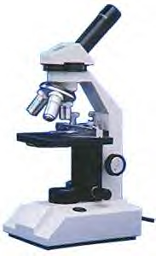
HISTORY OF THE CELL
1665 -ROBERT HOOKE observed cork cells (dead)
and named the “cell”.
1675 – ANTON VON LEEUWENHOEK first to describe living cells seen through a simple microscope.
Compound light microscope: series of lenses that magnify objects.
1665 - HOOKE observed cork cells (dead)
and named the “cell”.
SCHLEIDEN ,SCHWANN AND VIRCHOW are the
authors of the CELL THEORY

Slide 3

CELL THEORY
1. The CELL is the basic functional and structural unit of all life .
2. All LIVING THINGS are composed of cells, cell parts, or cell products.
3. All cells come from pre-
existing cells.

Slide 4
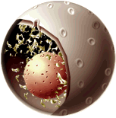

Eukaryote cell- Prokaryote cell

Slide 5
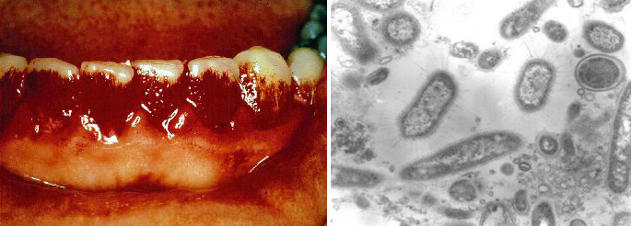
Two Cell Types
1. Prokaryotic cells have no membrane bound nucleus nor membrane bound organelles.
Most are single-celled.
Examples are bacteria and cyanobacteria

Slide 6

Two… Cell Types
Eukaryotic cells have a membrane bound __nucleus and membrane bound organelles.
Either single-celled or multicellular.
Organelles are separated by membranes so several processes can be going
on at once.
Lynn Marguli’s hypothesis
suggests that eukaryote
cells come from
prokaryote cells.

Slide 7
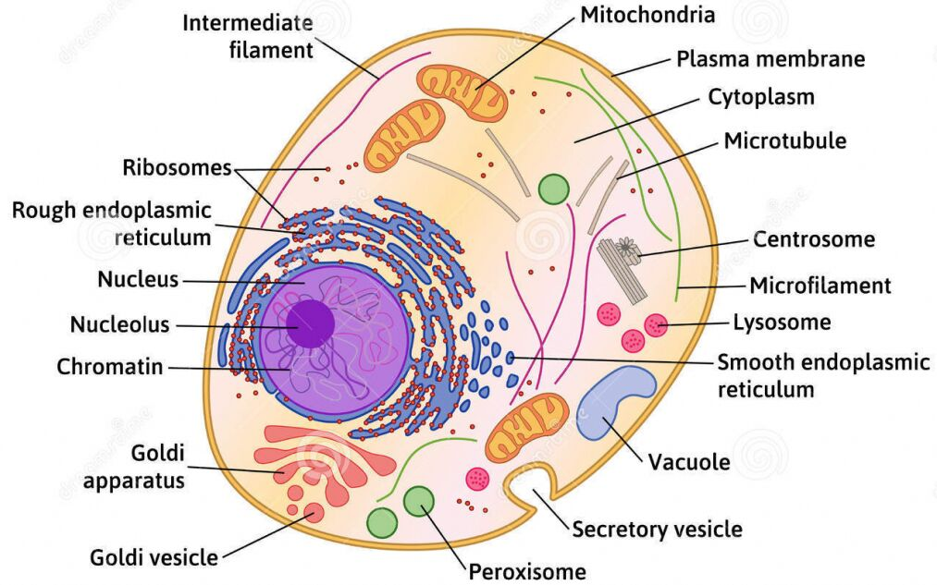
Part 2 – what is in a human cell

Slide 8
Plasma Membrane
This phospholipid bi-layer membrane acts as a selectively permeable gateway for the passage of substances into and out of the cell!
Boundary between cell and environment.
Controls materials that enter and exit the cell.
Example: oxygen & nutrients IN -wastes OUT
The membrane also contains proteins embedded within its phospholipid layers that act to encourage molecular movement, or as recognition molecules.

Slide 9
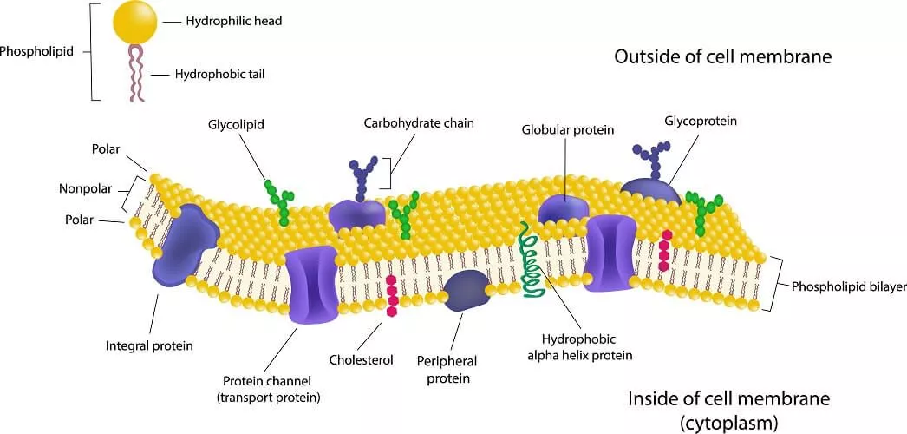

Slide 10
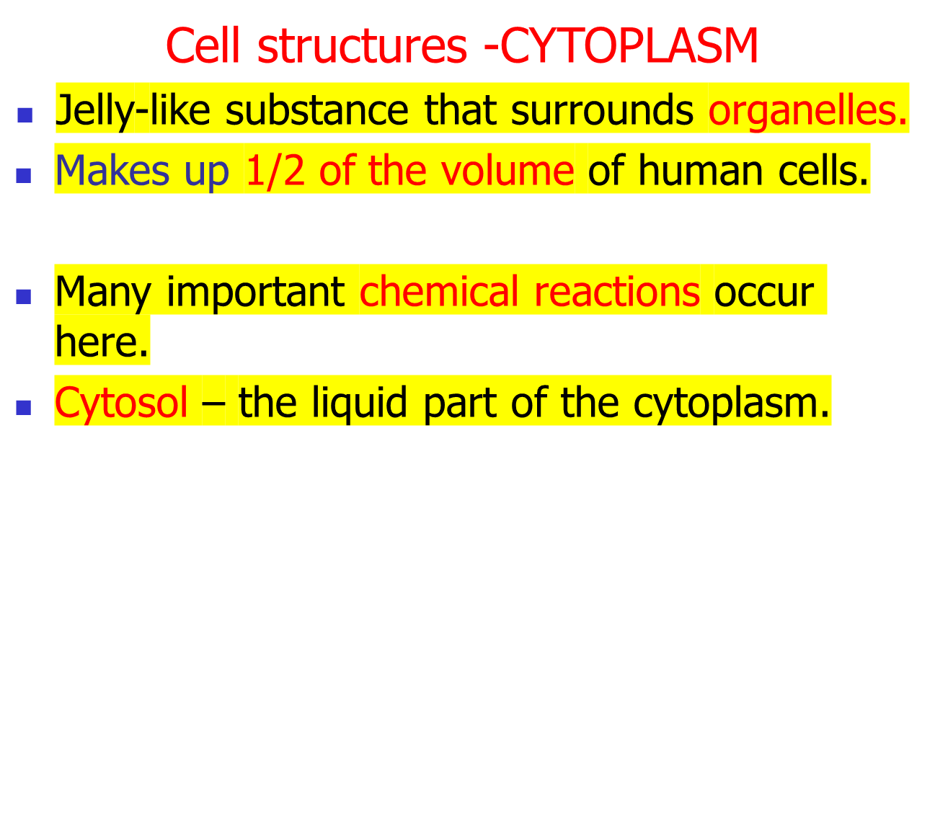
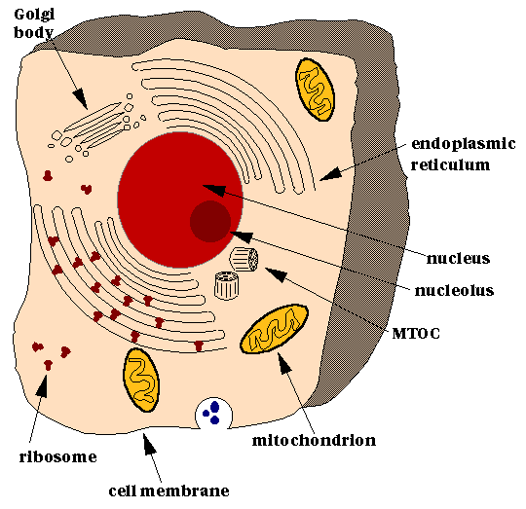

Slide 11
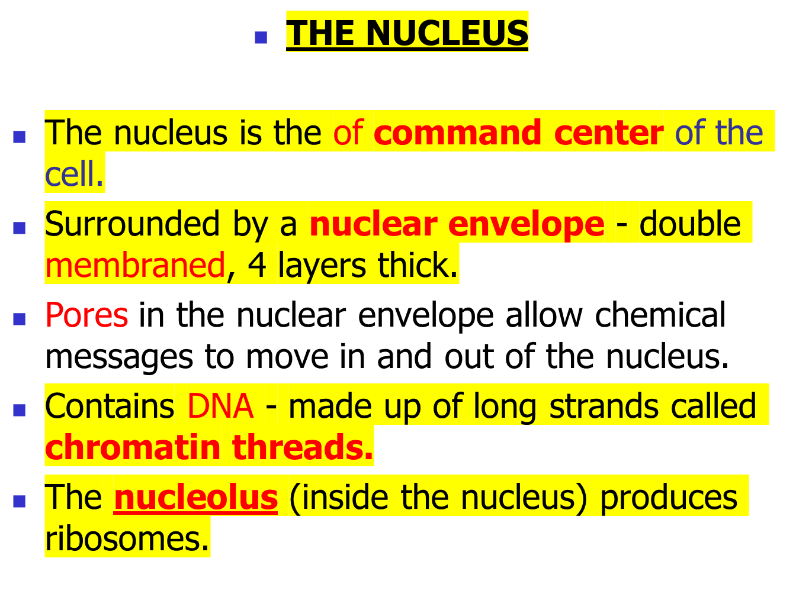
ORGANELLES:

Slide 12
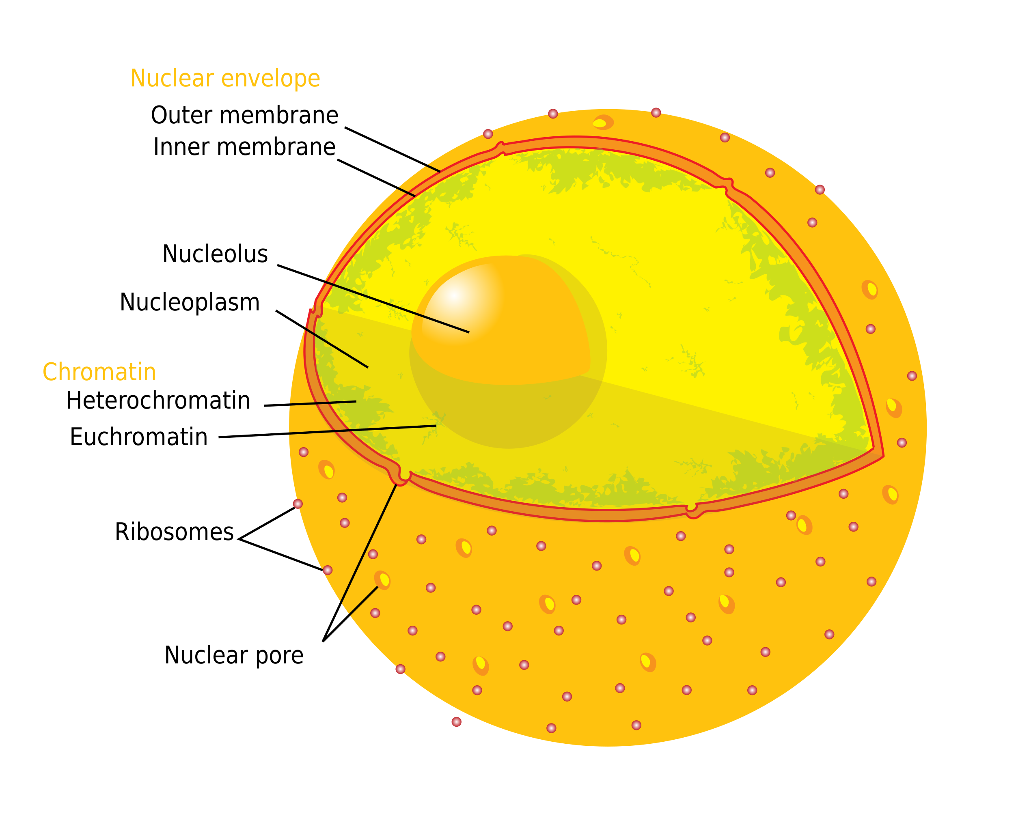

Slide 13

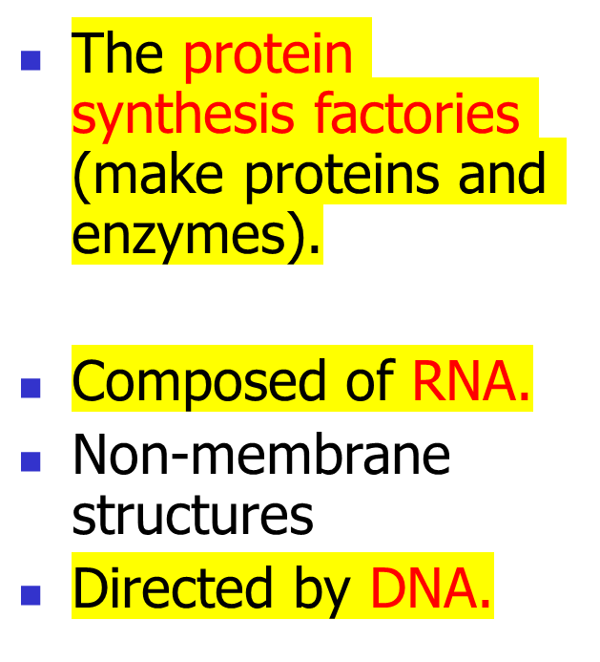

Rough endoplasmic reticulum
Ribosome------ >

Slide 14

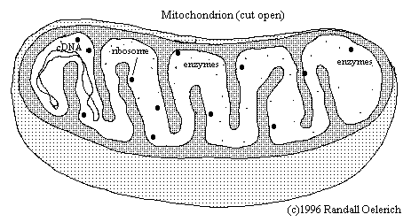
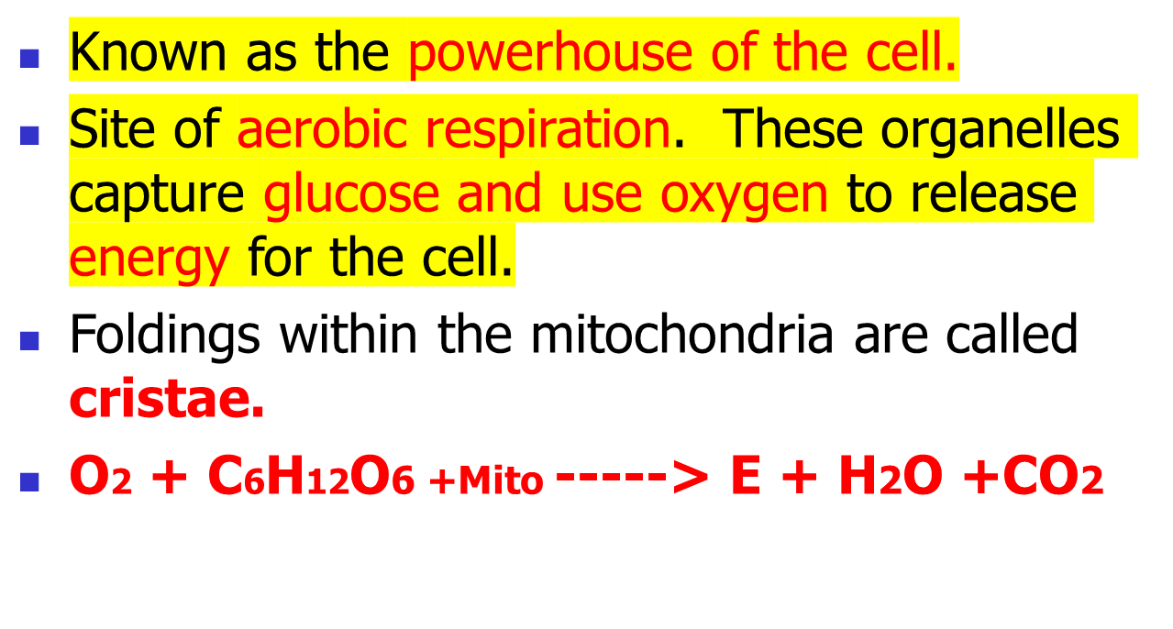


Slide 15
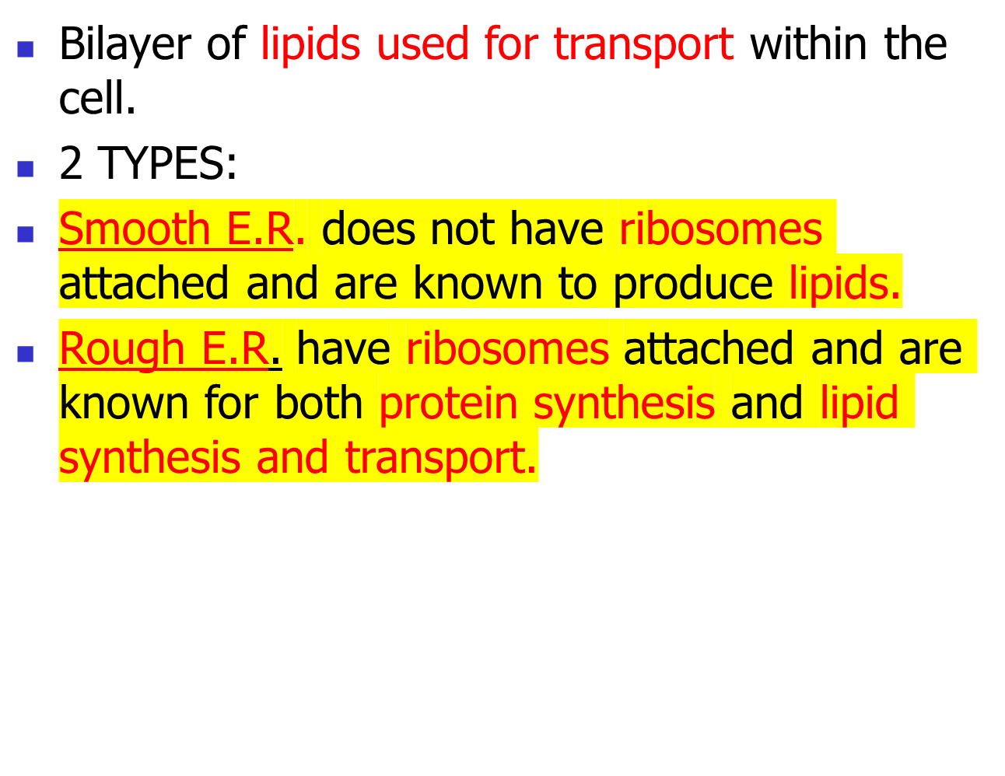
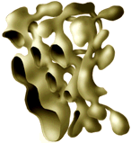
ENDOPLASMIC RETICULUM (ER)

Slide 16


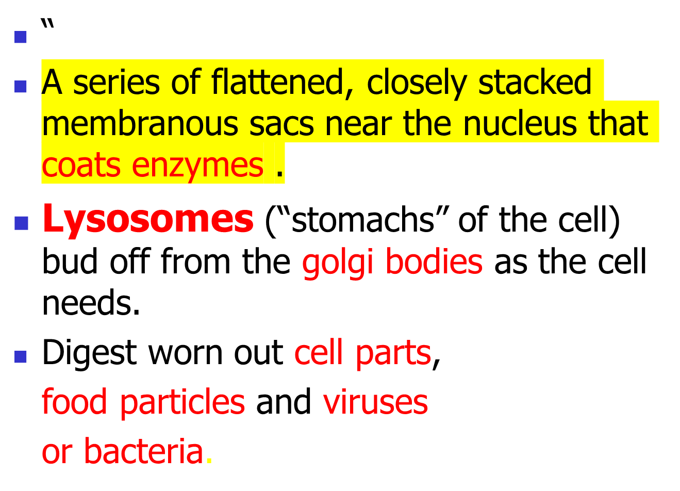

Notes:
digestive proteins

Slide 17
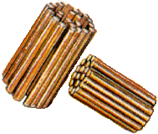

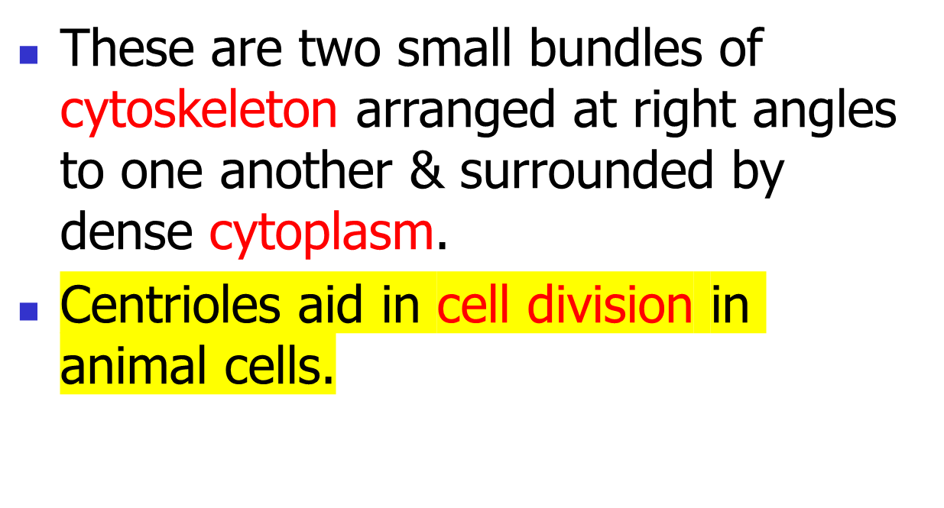

Slide 18
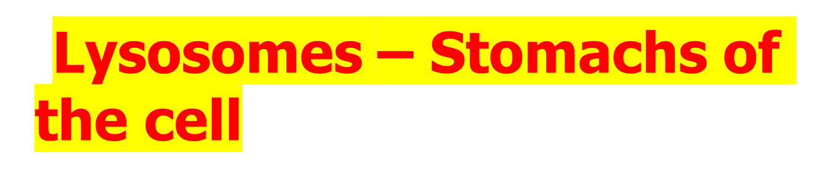
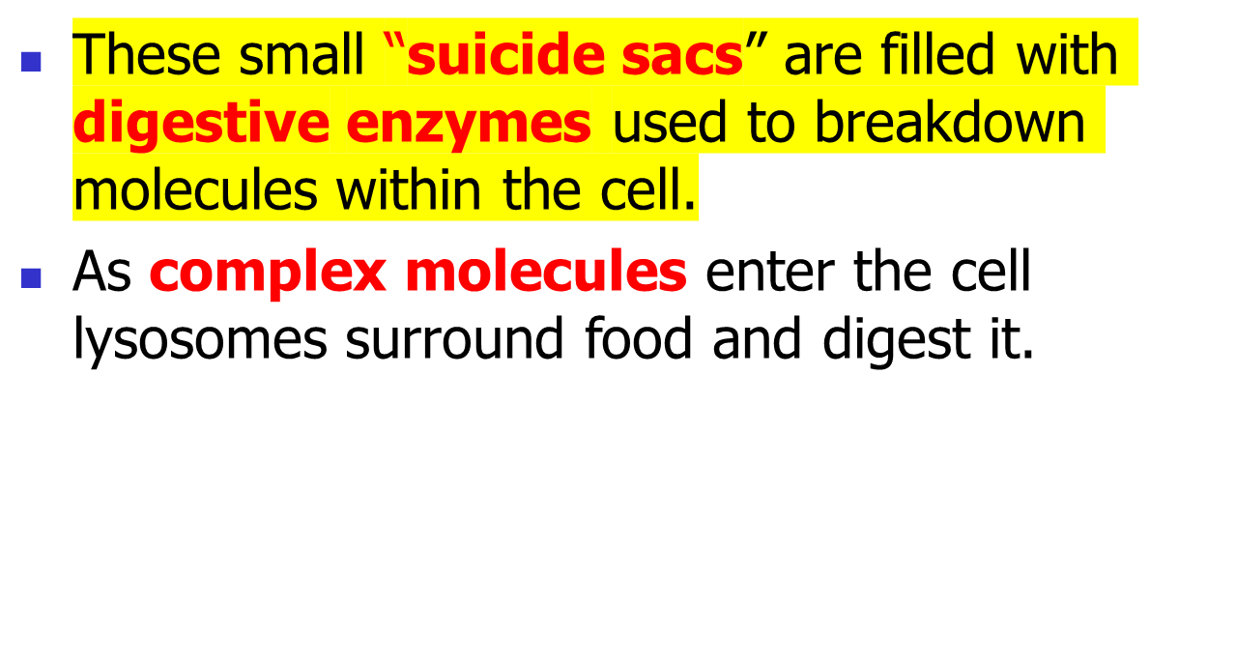
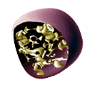

Slide 19
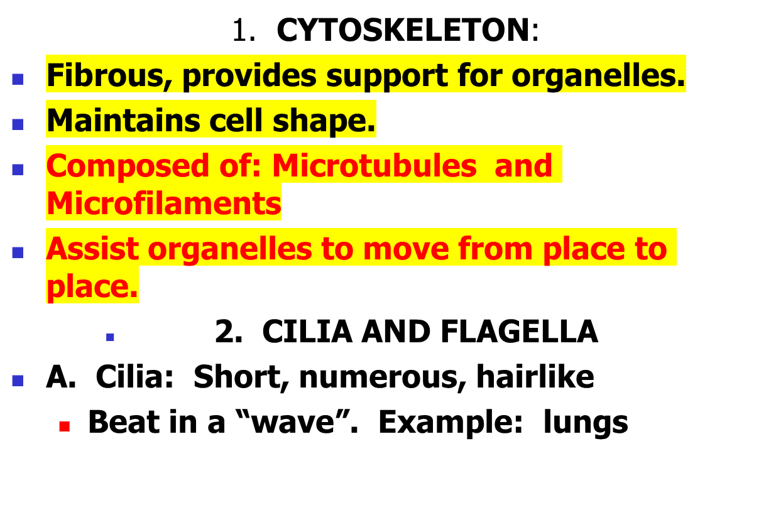
MOVEMENT AND SUPPORT

Slide 20
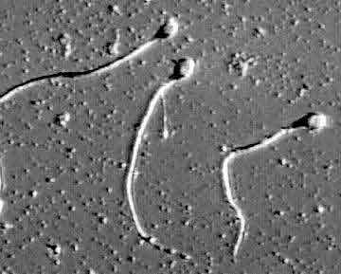
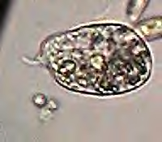
B. Flagella: Longer, 1-2 per cell.
  Move in a whip-like motion.
  Example: sperm cells
  Single-celled organisms usually depend on cilia or flagella to move.
  Multi-cellular organisms use cilia on cells to move fluids over the surface of tissues.

Slide 21


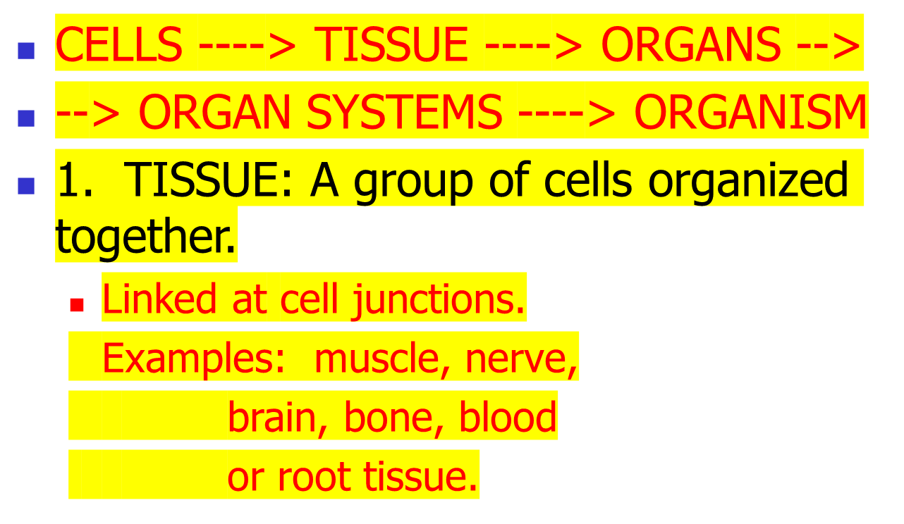
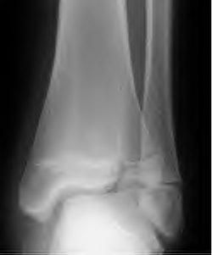
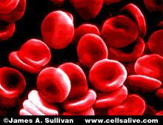

Slide 22
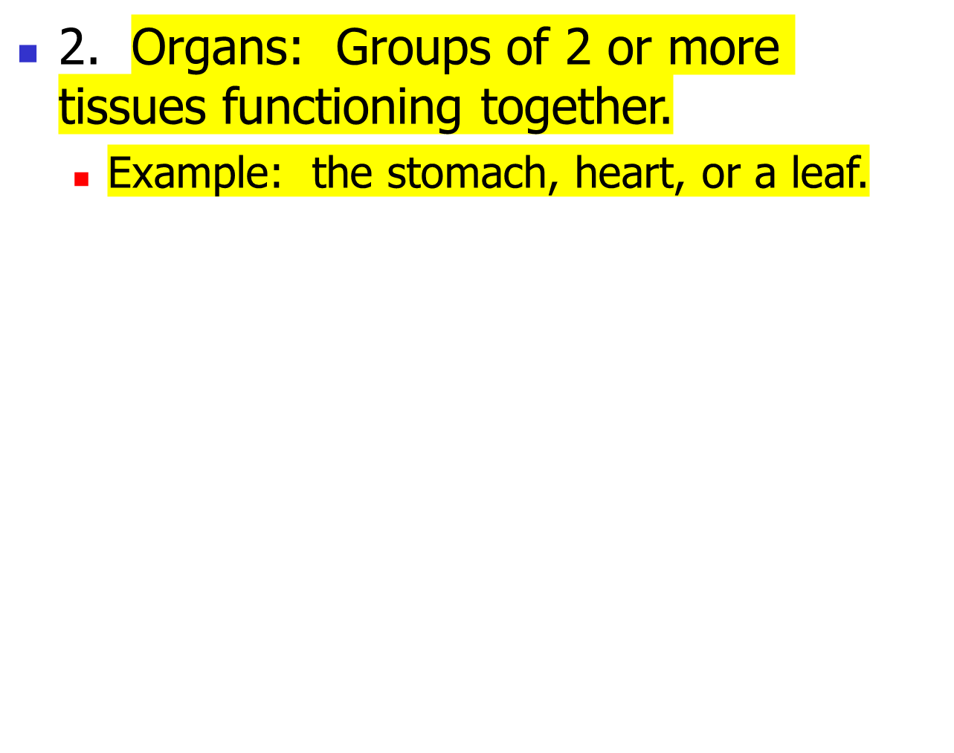
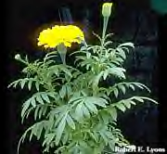
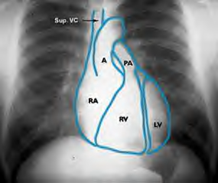

Slide 23
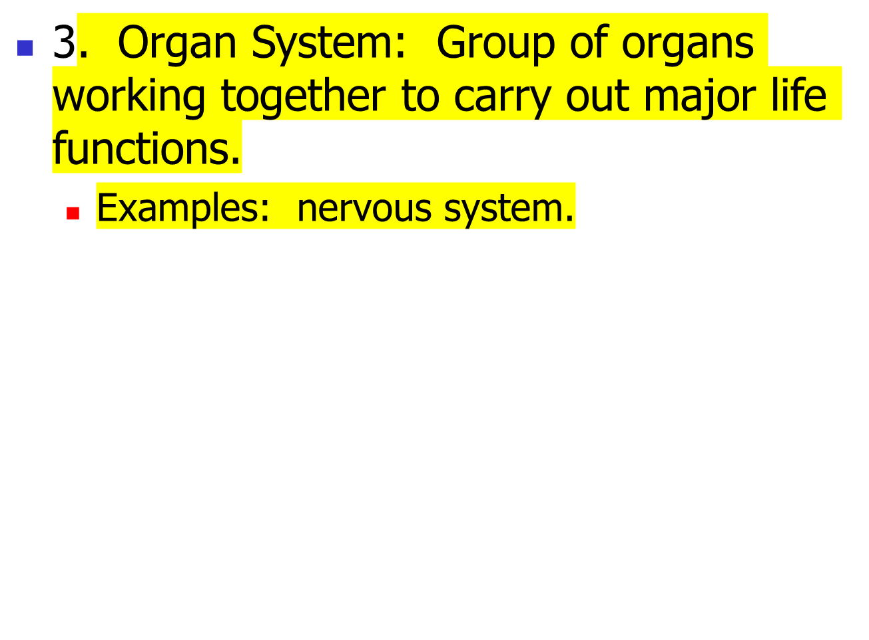


Slide 24
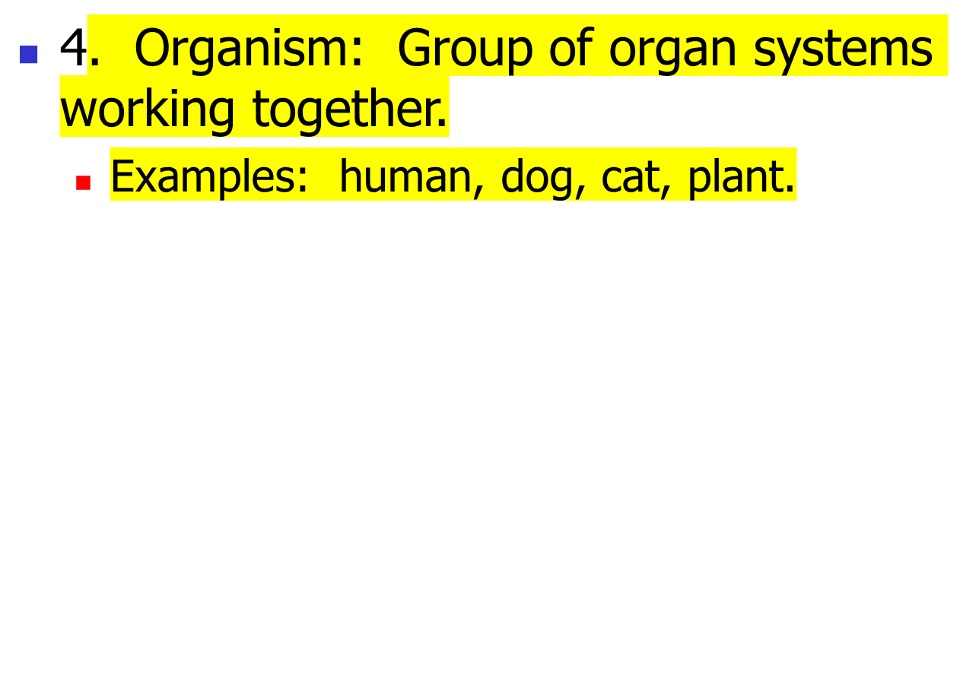






Slide 25
Why can’t cells grow to a Ginormous SIZE?????
The ability of the cell membrane to absorb and release substances prevents them from growing large.
One way to explain this is to say the surface area to volume ratio….demonstrates that there is not enough surface area to absorb nutrients quickly enough to keep the cell alive as it grows larger…thus the cell must divide.

